Slide 1
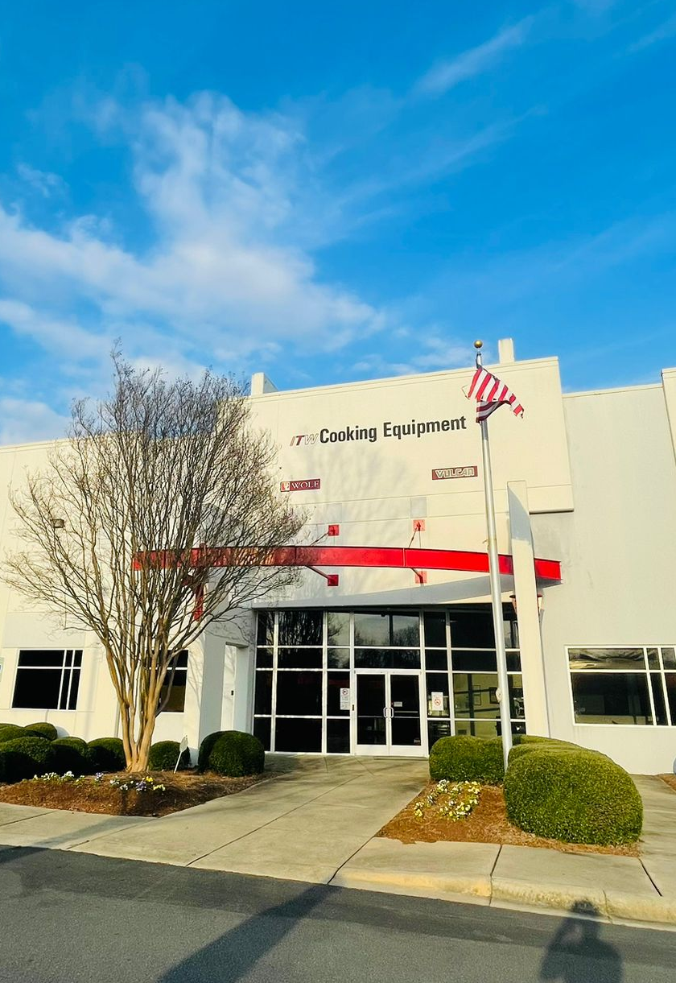
Proposal Presentation Illinois Tool Works Charlotte, North Carolina
Elizabeth Pollack
Eric Yoon
Kamalesh Krishna Arunachalam
Krishna Vamsi Devarala

Slide 2

Company background
ITW is a global industrial company with seven industry-leading business segments
Our project focuses within the Industrial Food Equipment segment, specifically the Charlotte, North Carolina Plant
The Charlotte plant manufactures Char Broilers, Griddles and Fryers
Assemble, Test, Ship facility
Fryers moved to Charlotte in 2015

Slide 3
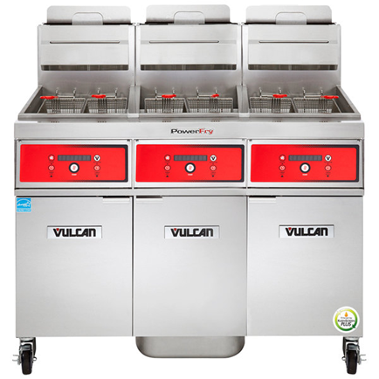
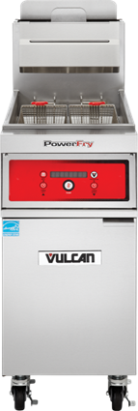
ITW Fryer description
ITW PowerFry line is their highest end product with patented technology
Several ways to configure PowerFry units
Number of Tanks: 1*,2,3,4
Tank Size: 45, 65, 85
Type of Tank: VR, TR
Controller: Analog, Digital, Computer
Gas: Propane, Natural Gas
Customizations: Oil Reclaim, Basket lifts, Heat Trace
Notes:
ITW manufactures three different Product Lines
Electric Fry
Gas Fry
Power Fry

Slide 4
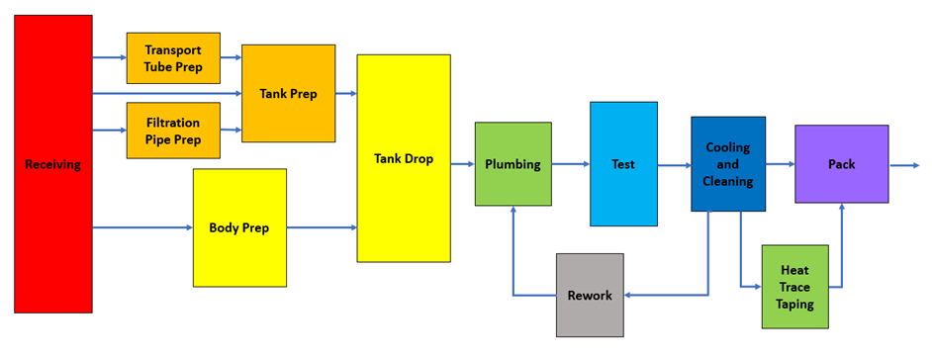
Process Overview
Six main stage of the PowerFry production process
Receiving
Tank Prep
Tank Drop
Plumbing
Test
Finishing and Pack

Slide 5
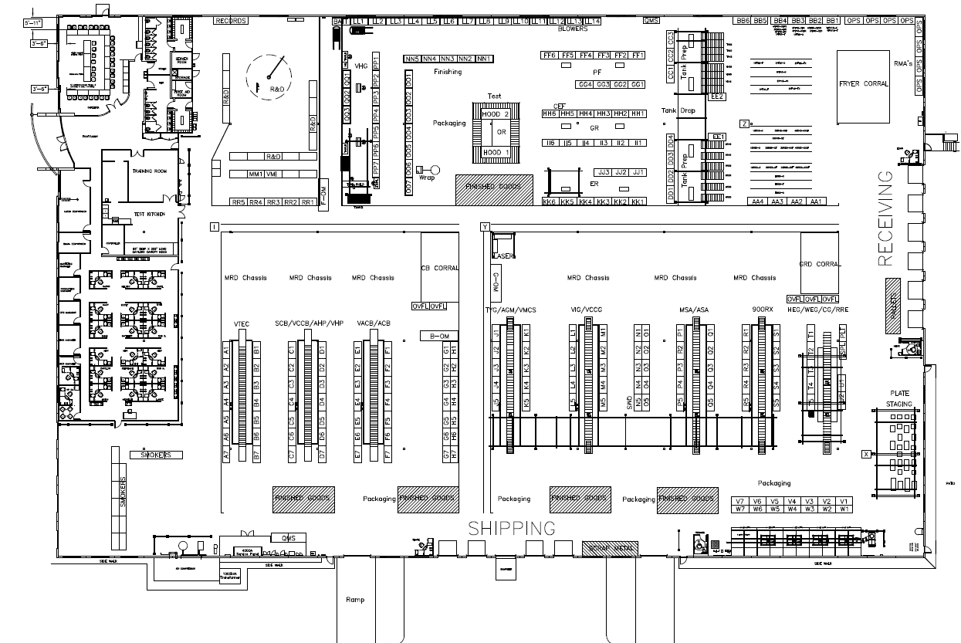
Receiving

Slide 6
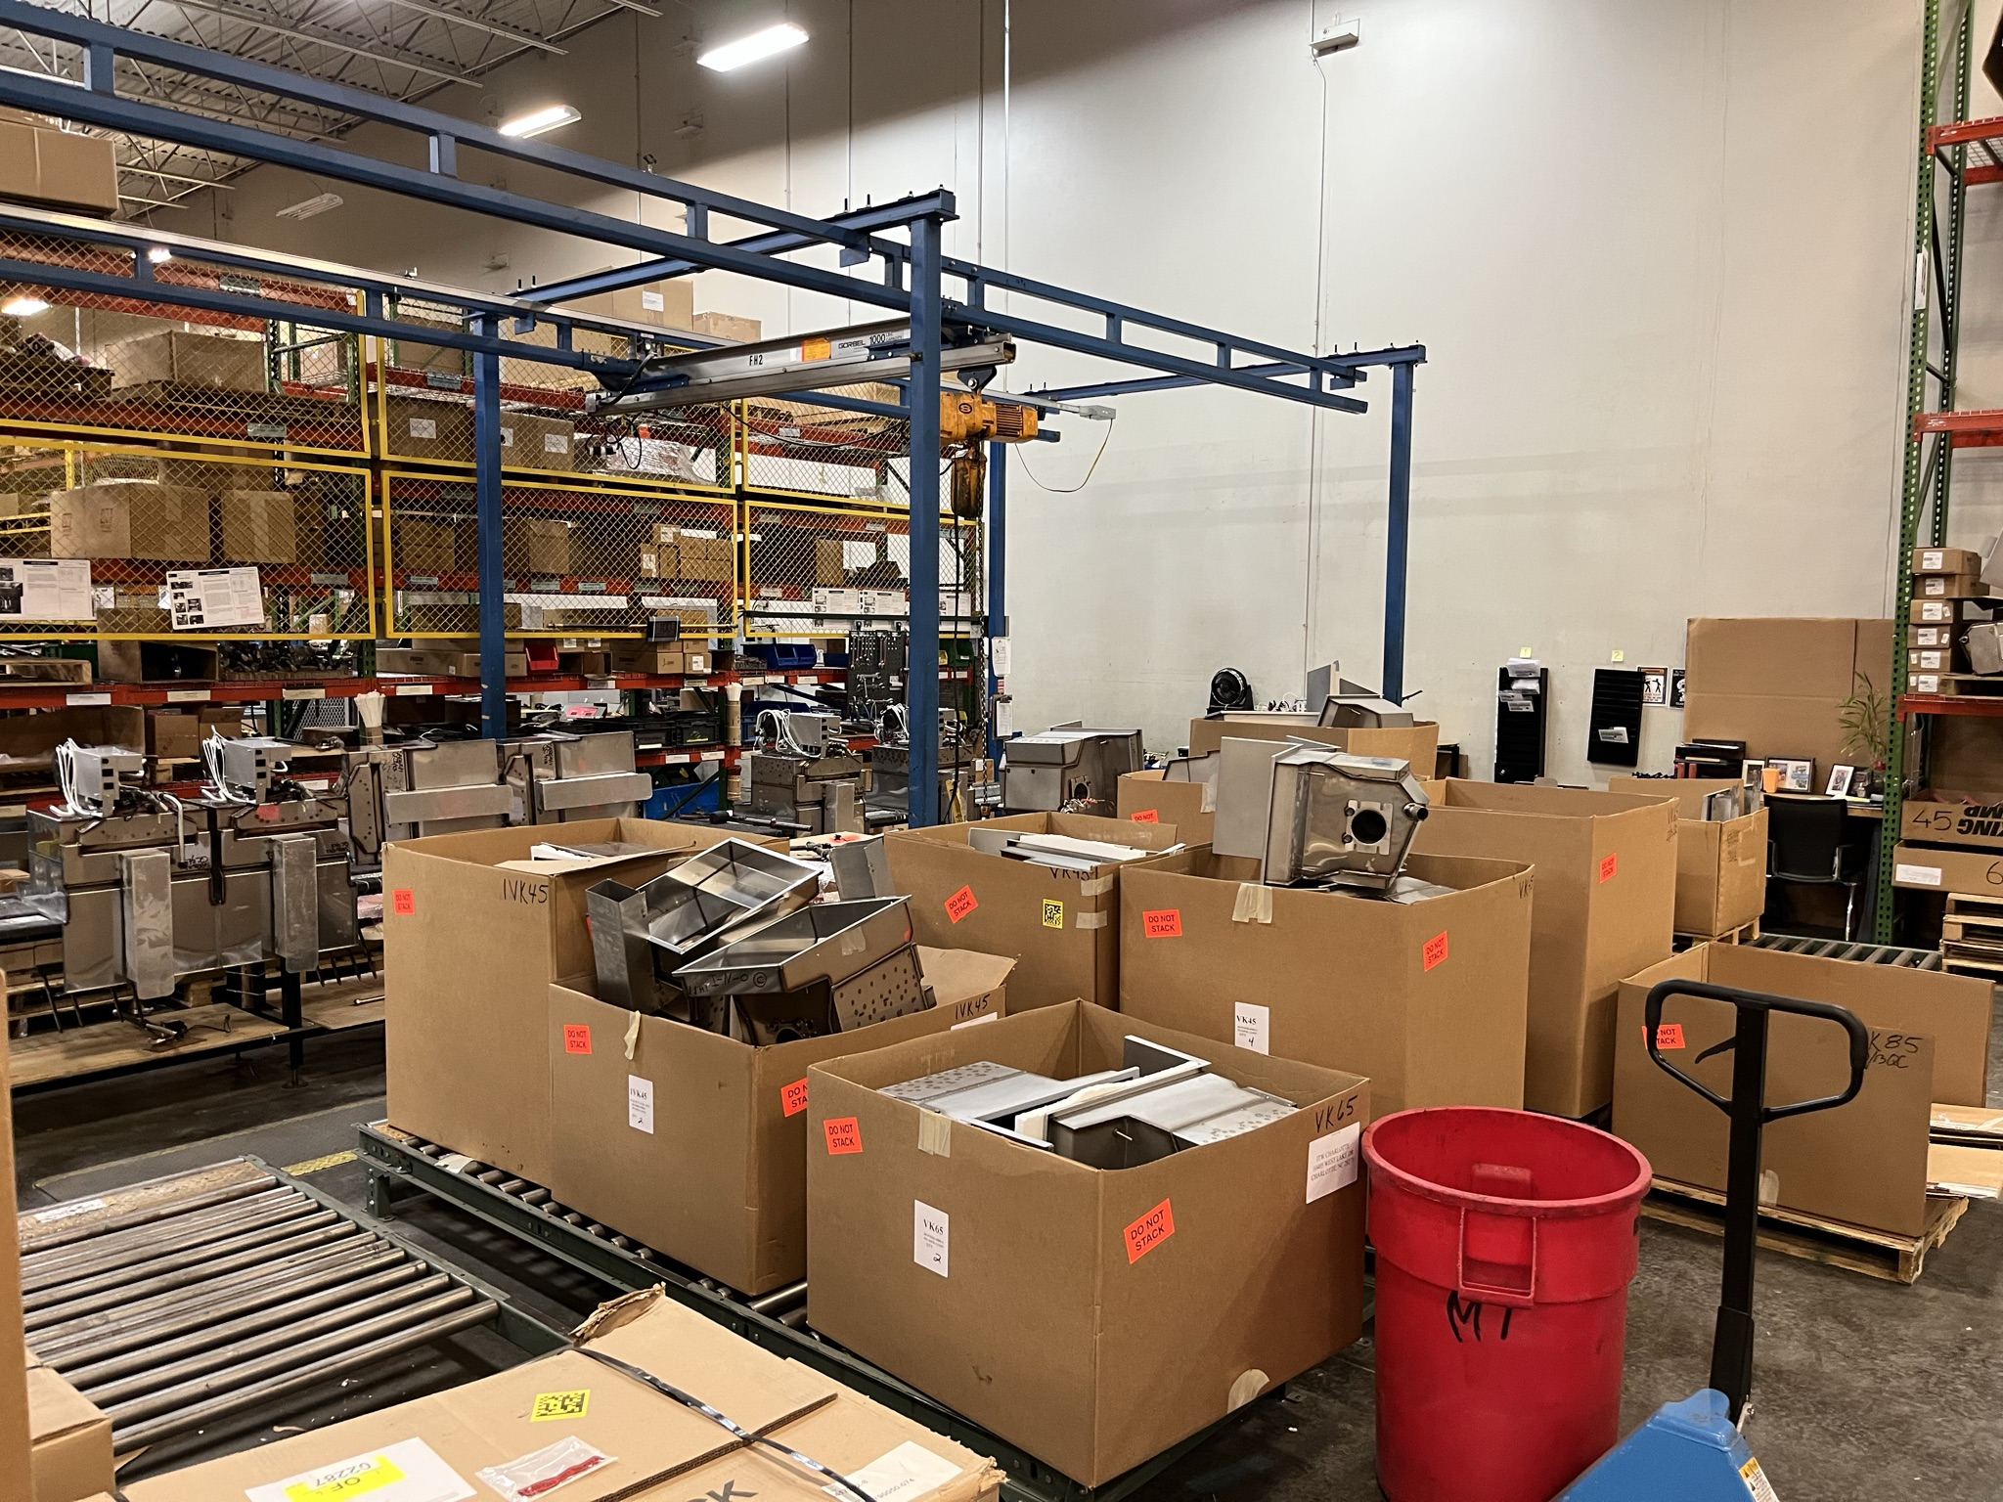
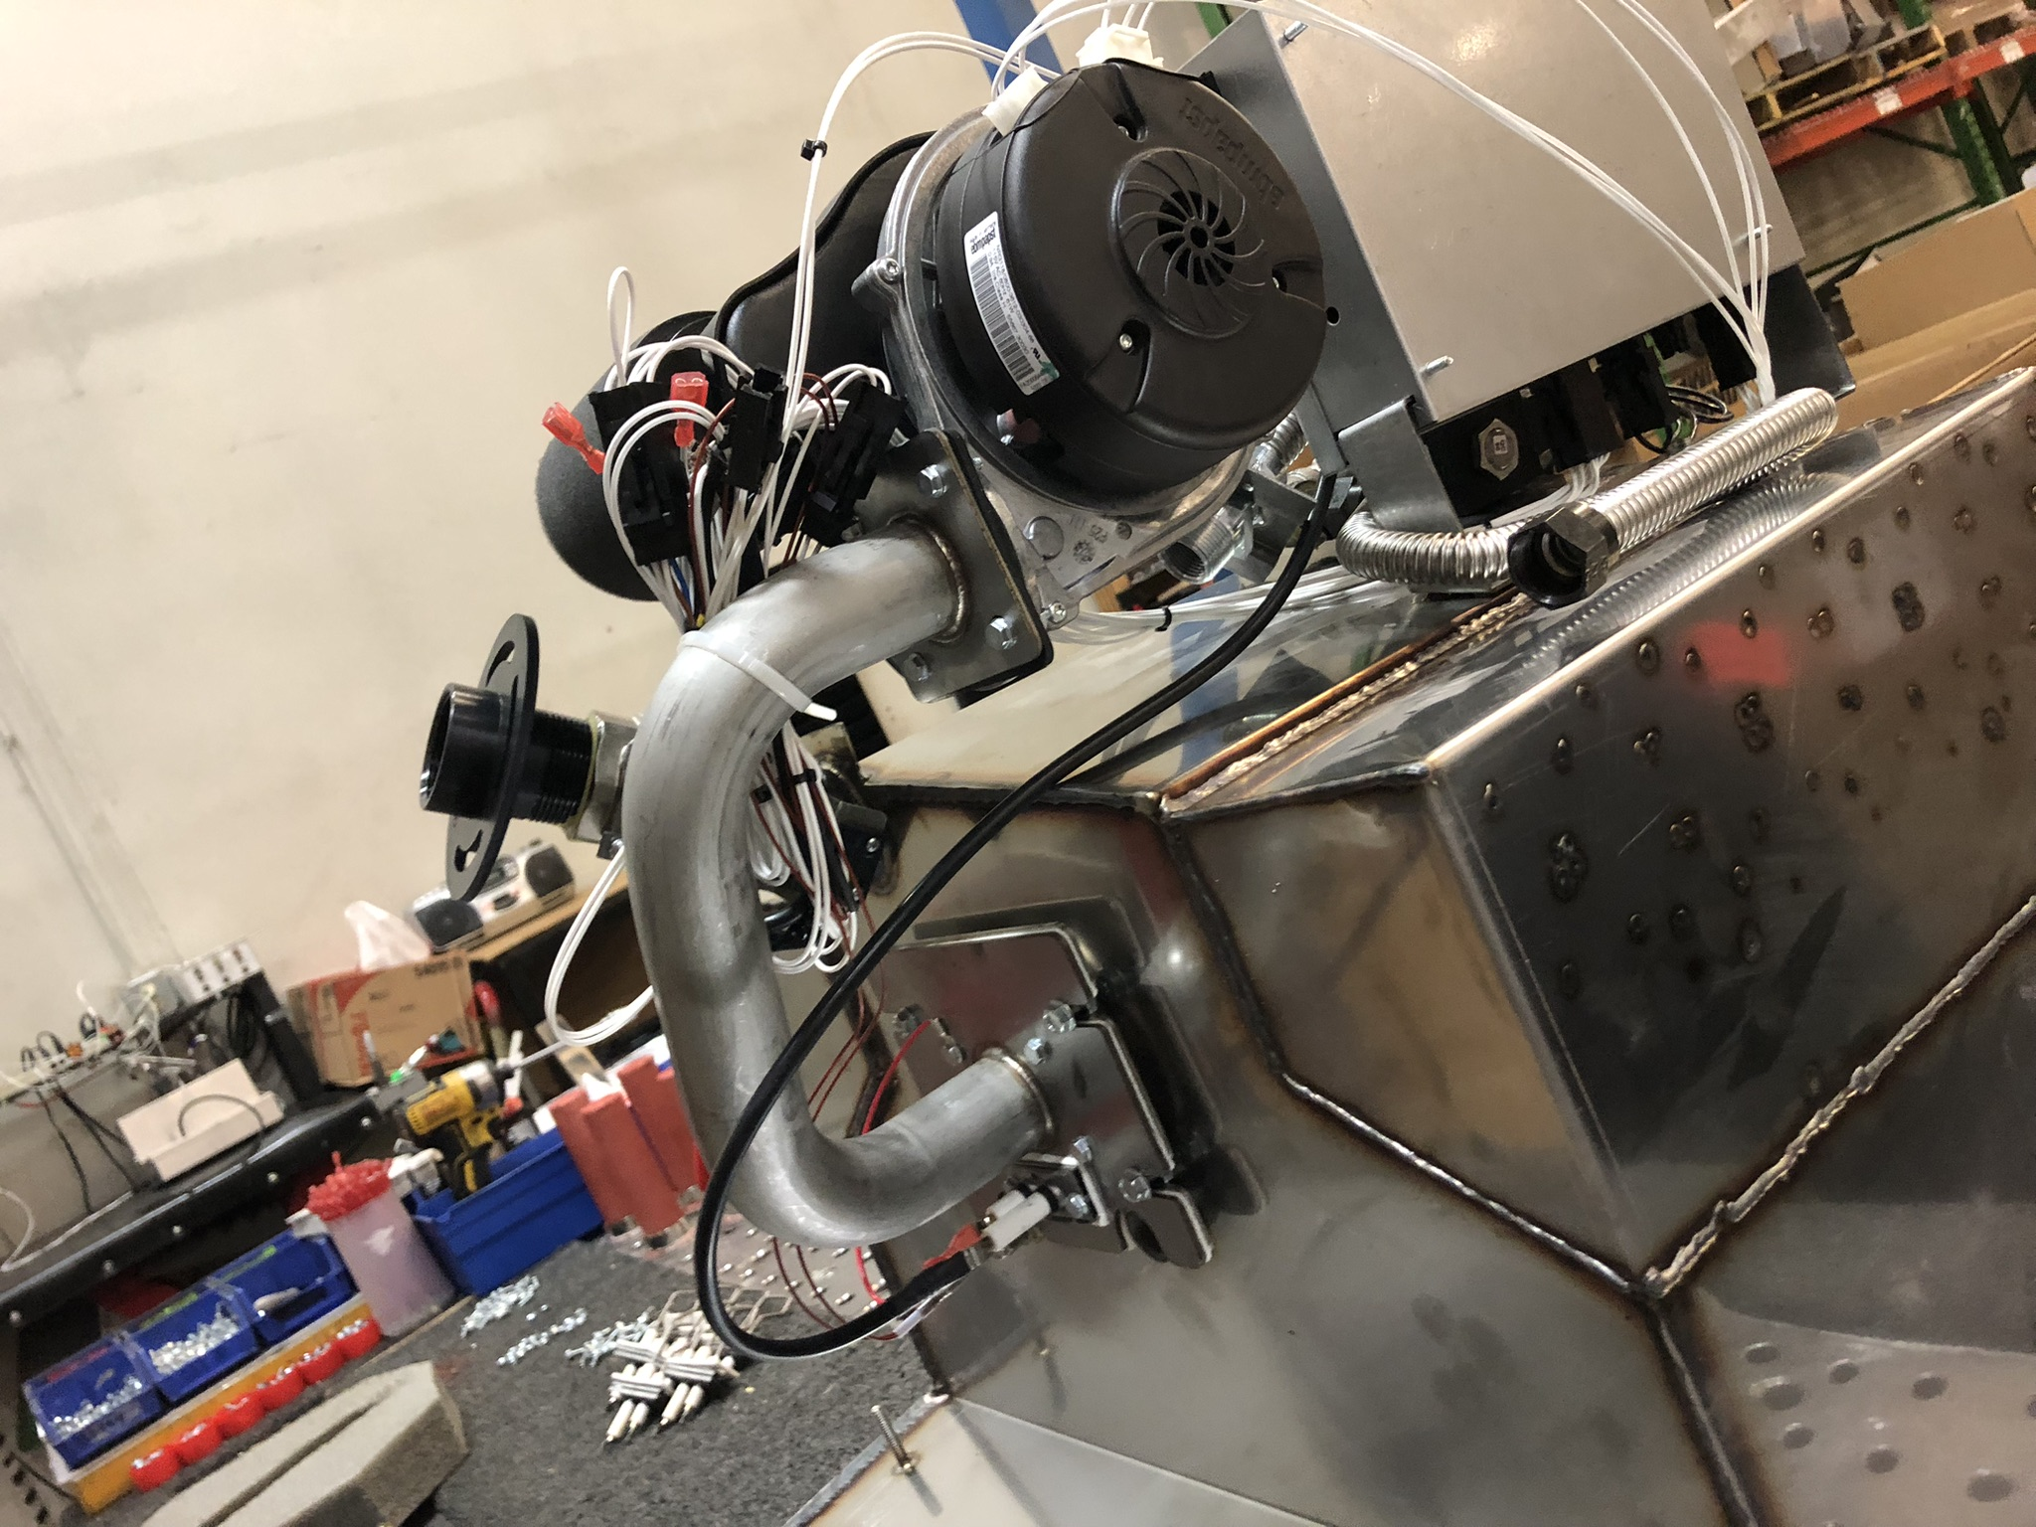
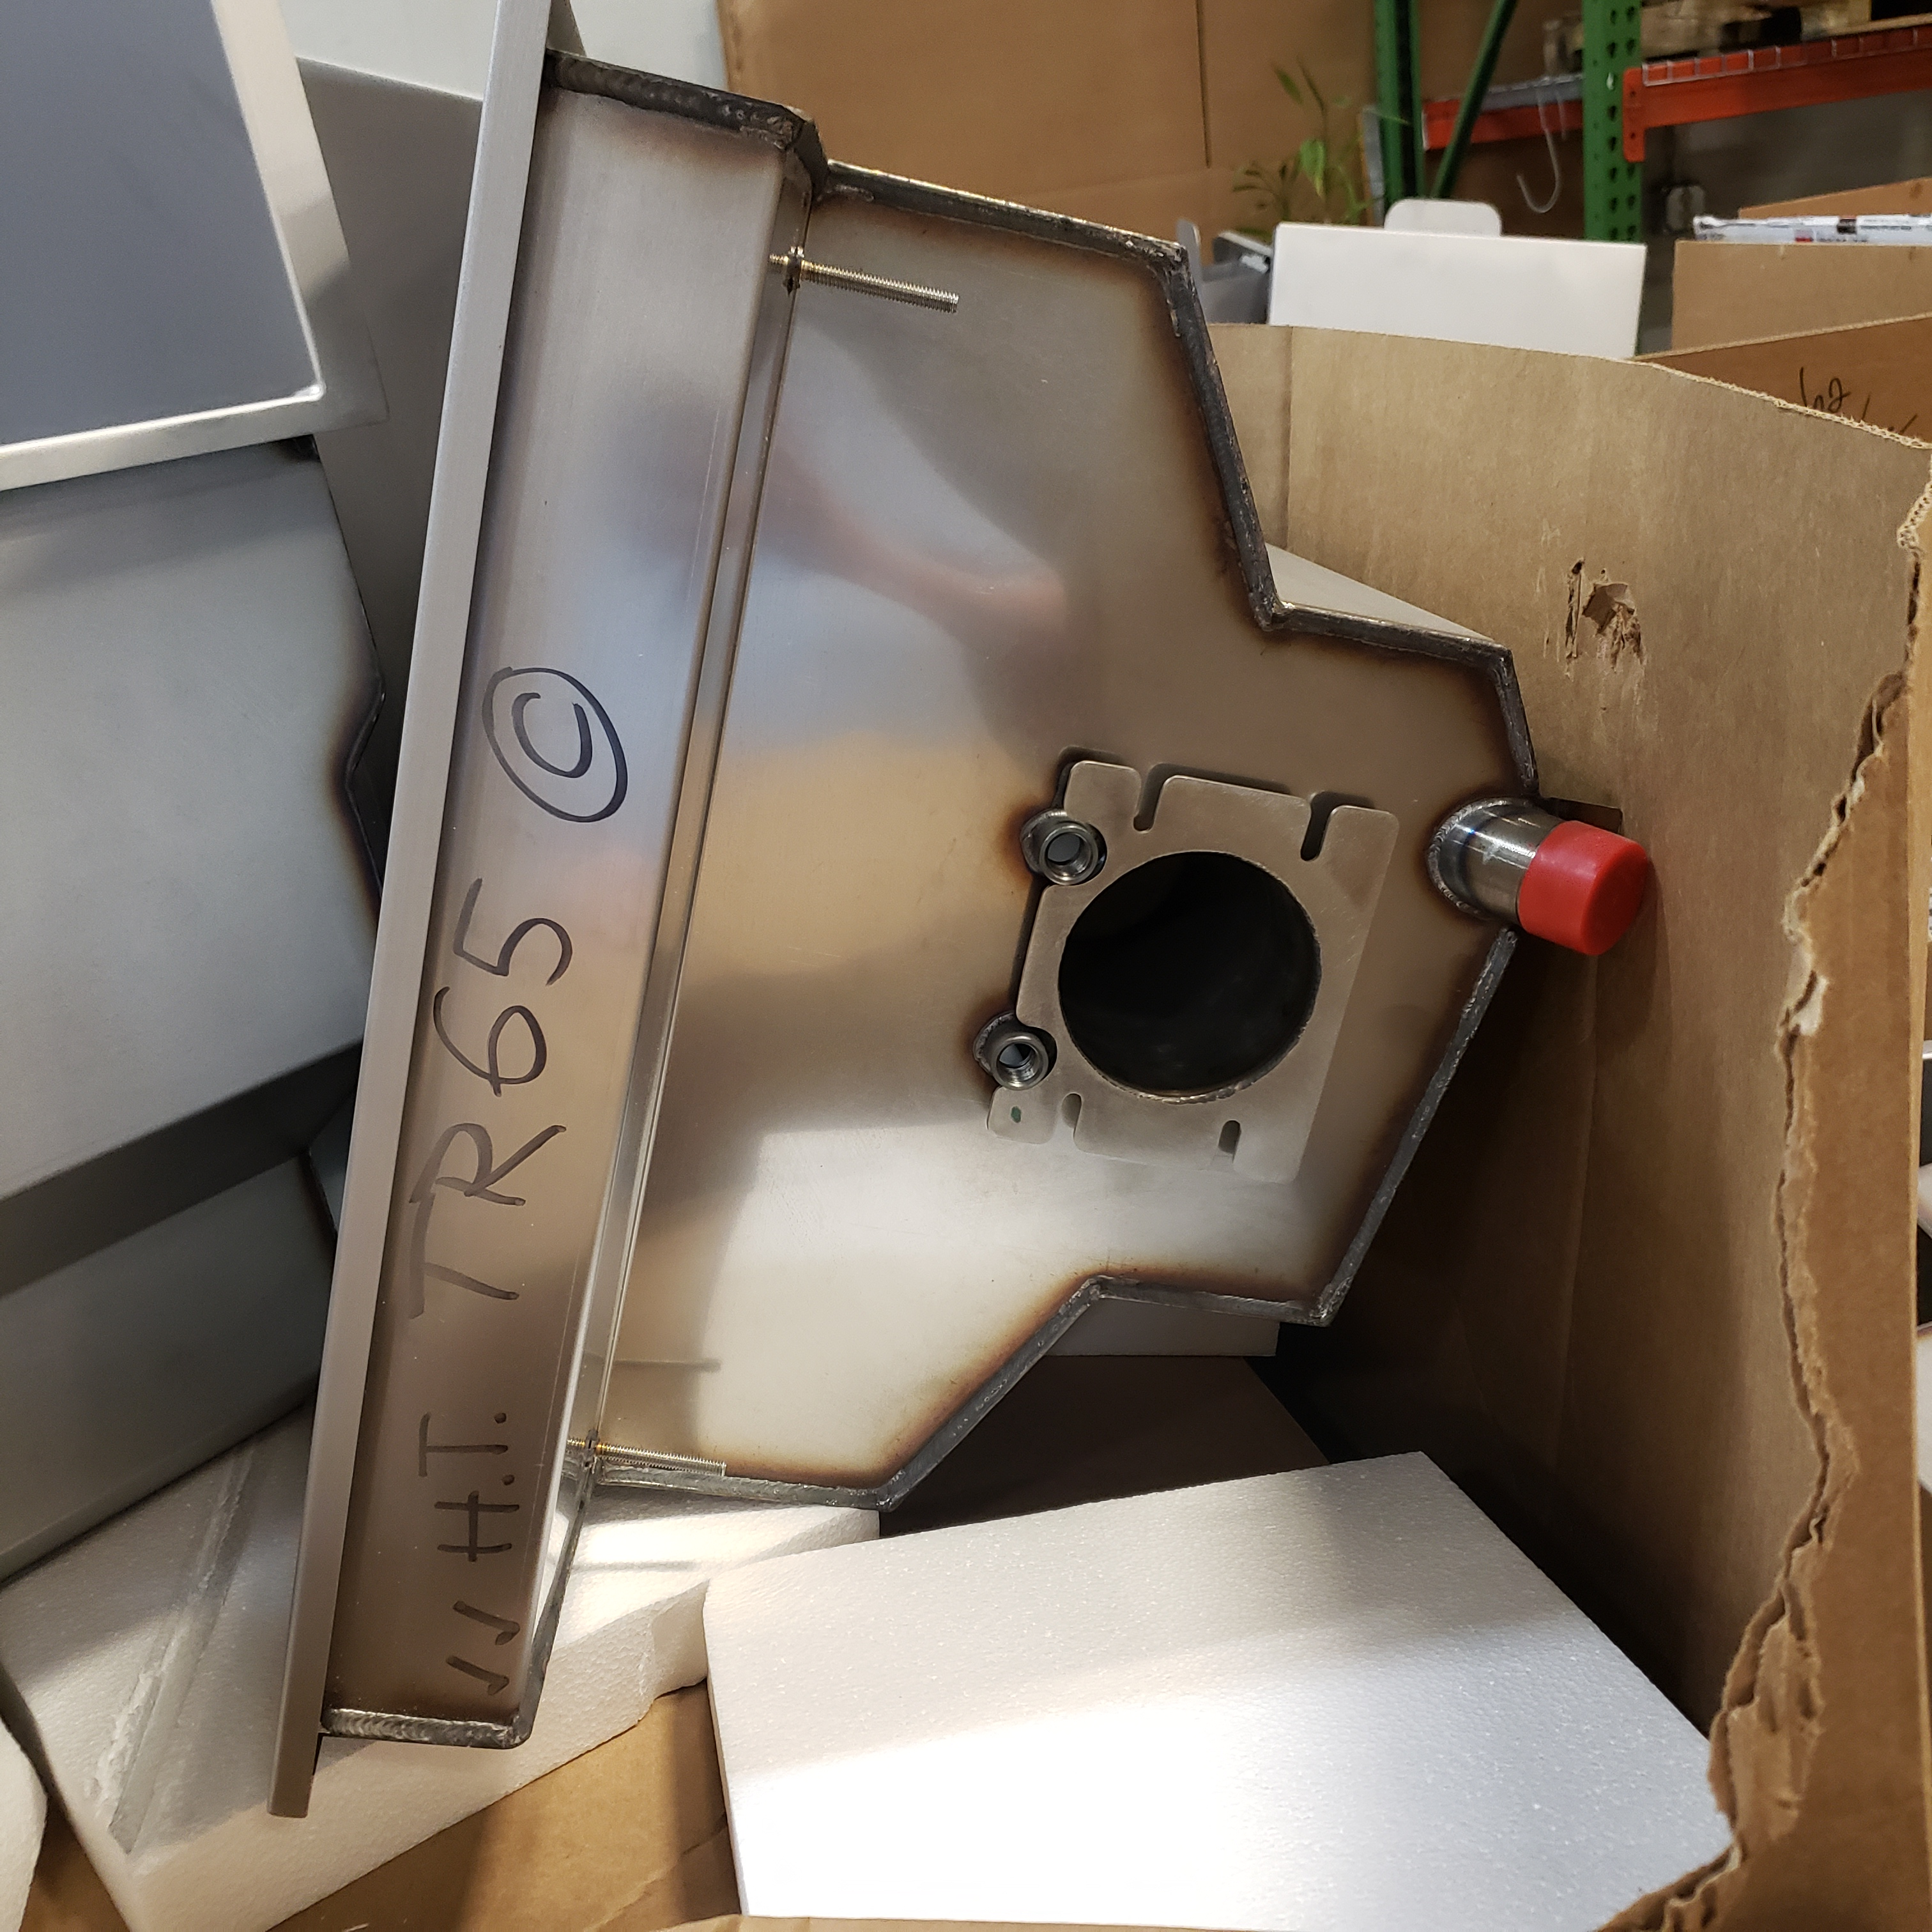
Tank Prep
Assemble Tanks in preparation for installation in the body of the Fryer Unit.

Slide 7
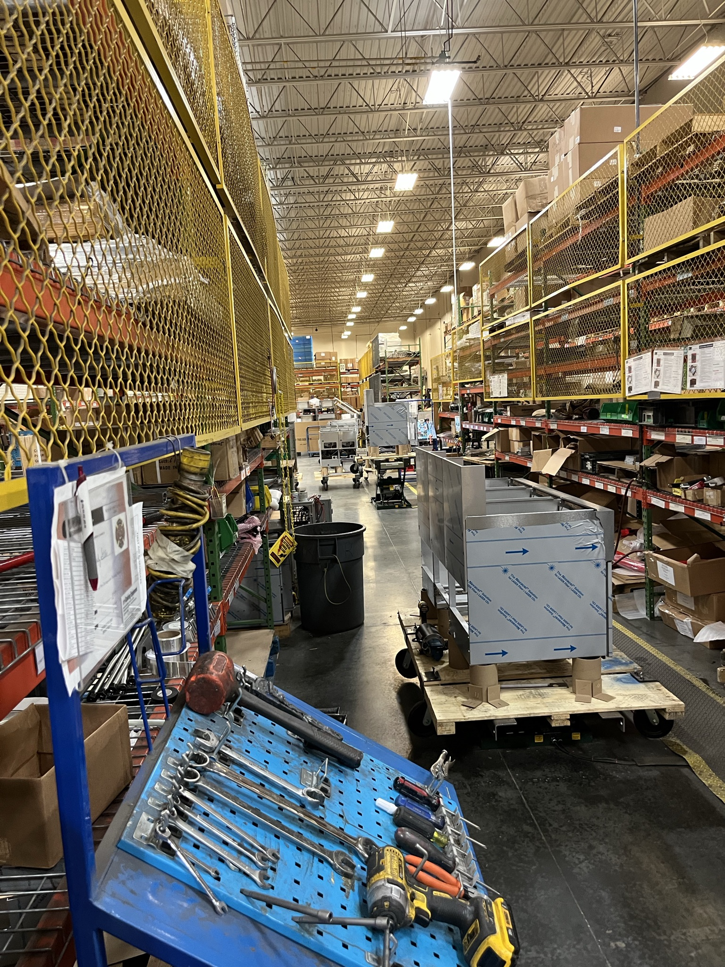
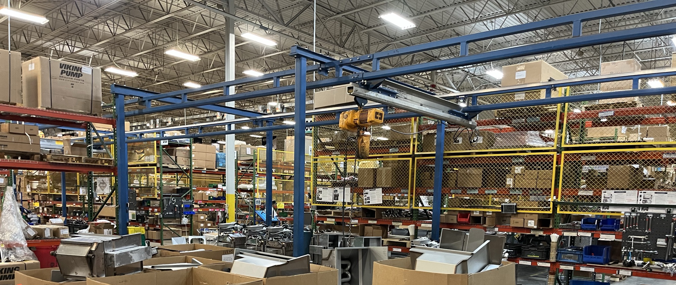
Tank Drop
Prepare the Fryer Body
Flue and pump
Use overhead lift to hoist assembled tanks into assembled bodies

Slide 8
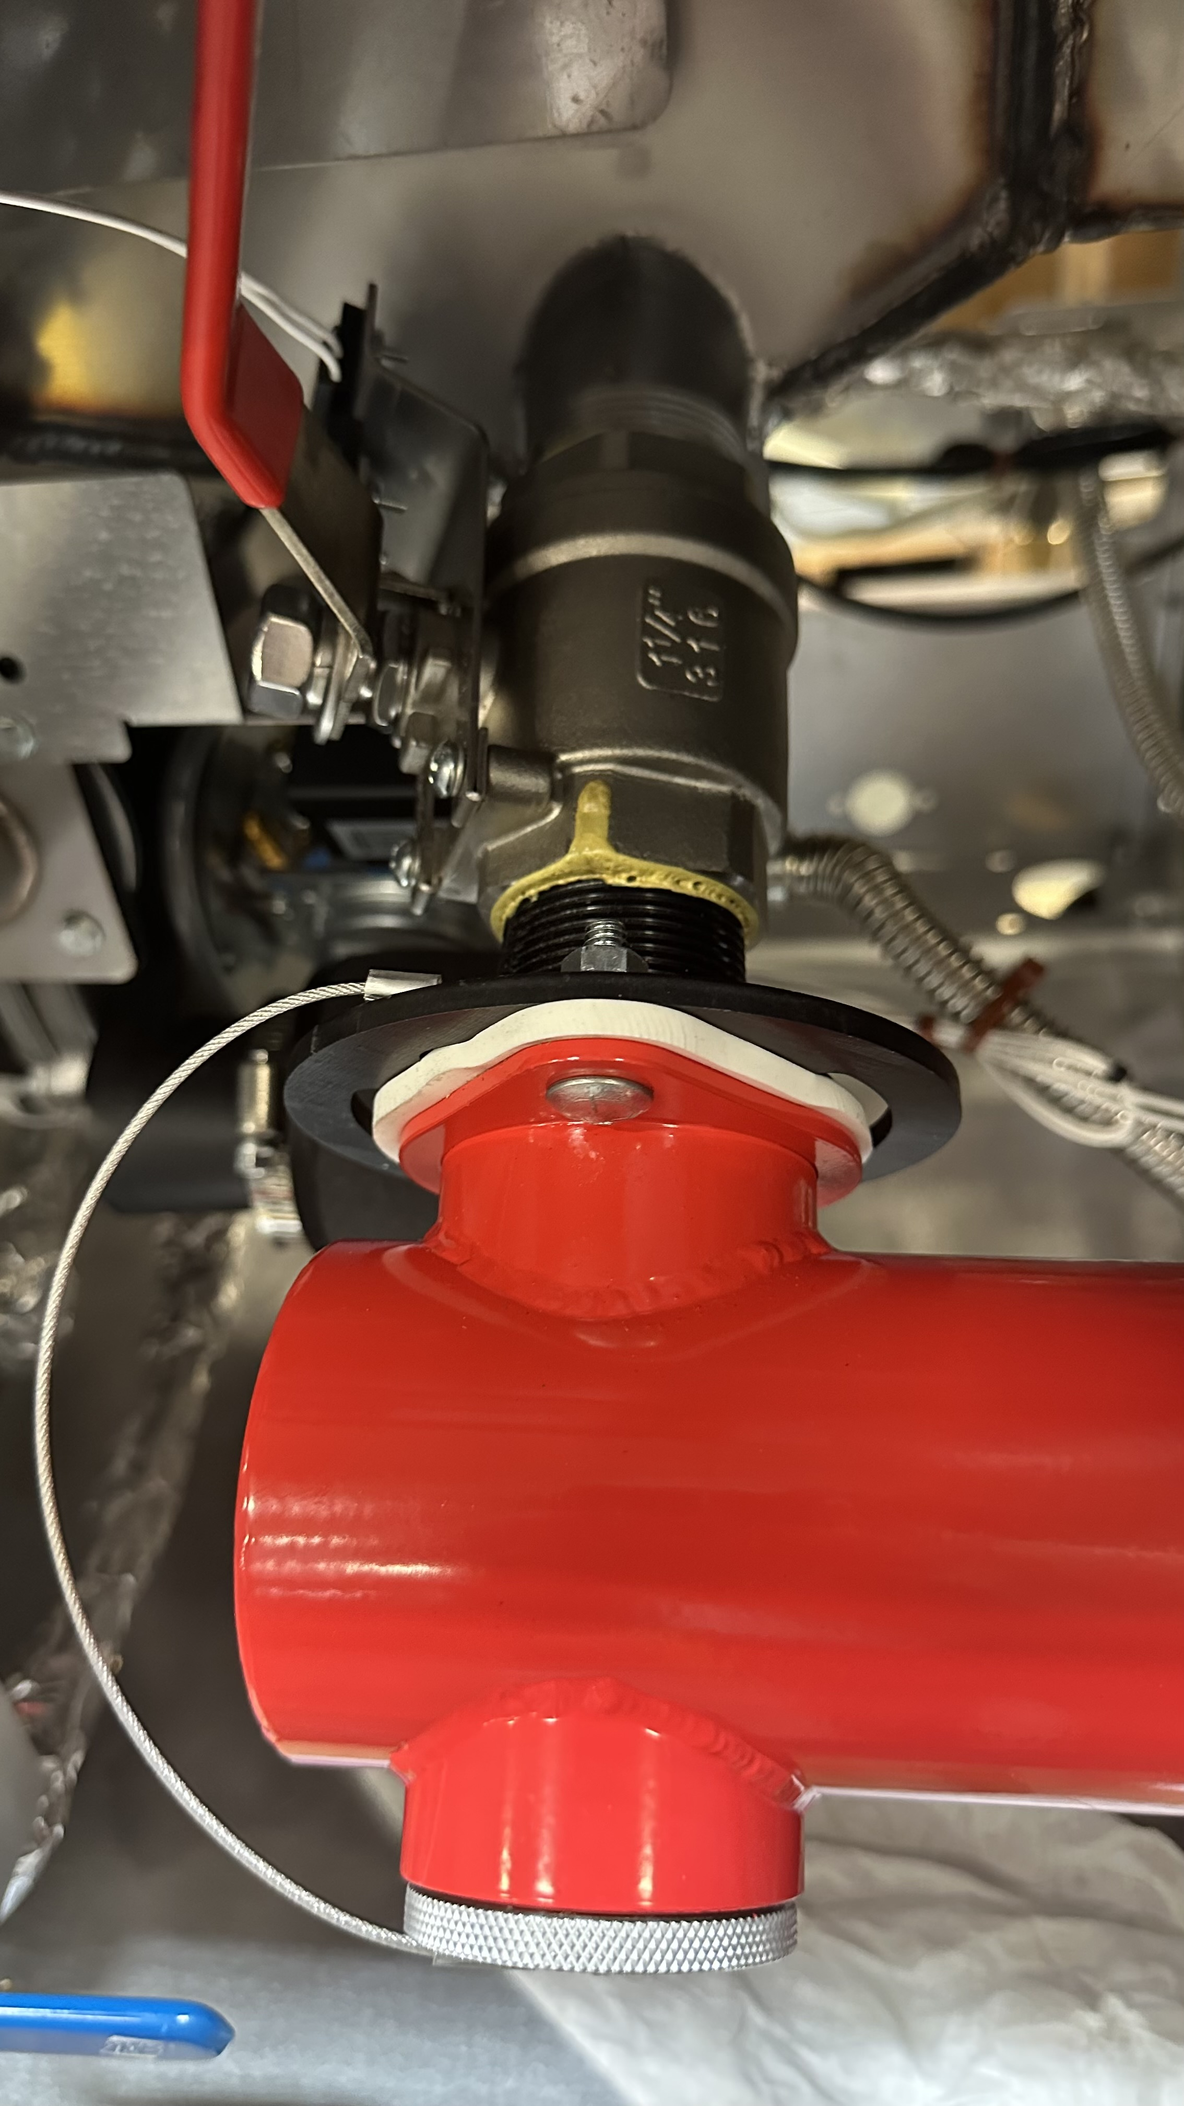
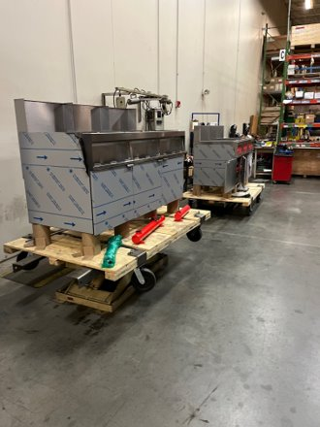
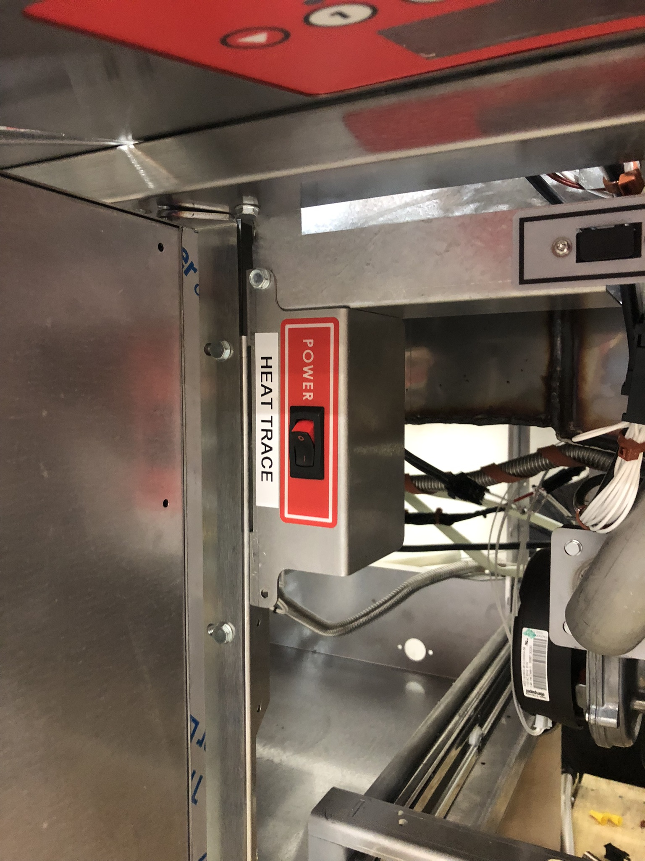
Plumbing
Finishing Assembling the Fryer Units
Connect all Oil, Gas, Electric, and Control systems
Program Control System
Wrap Heat Trace

Slide 9
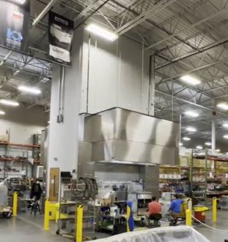
Testing
Testing is the main bottle neck of the process
Low Limit Testing at 135°F, and High Limit Testing at 350°F
Oil Cycle through pump, filter and tank
Check for leaks
Drain tank and let cool
Clean

Slide 10
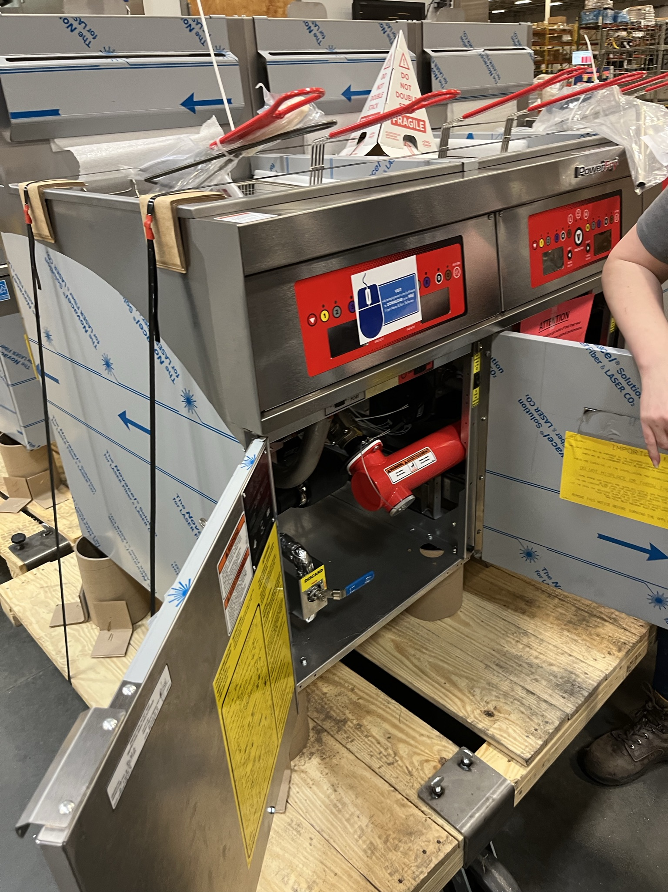
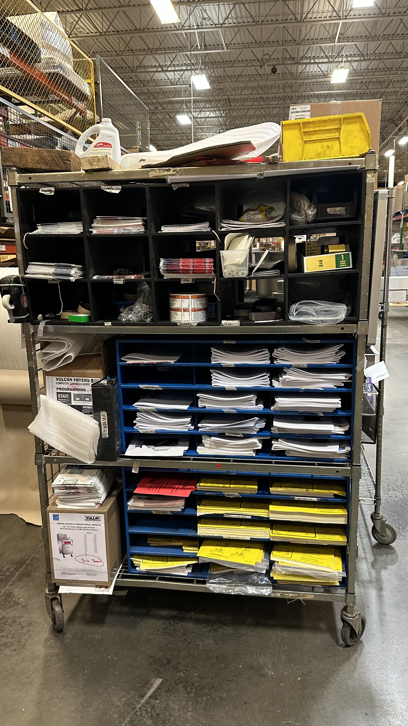
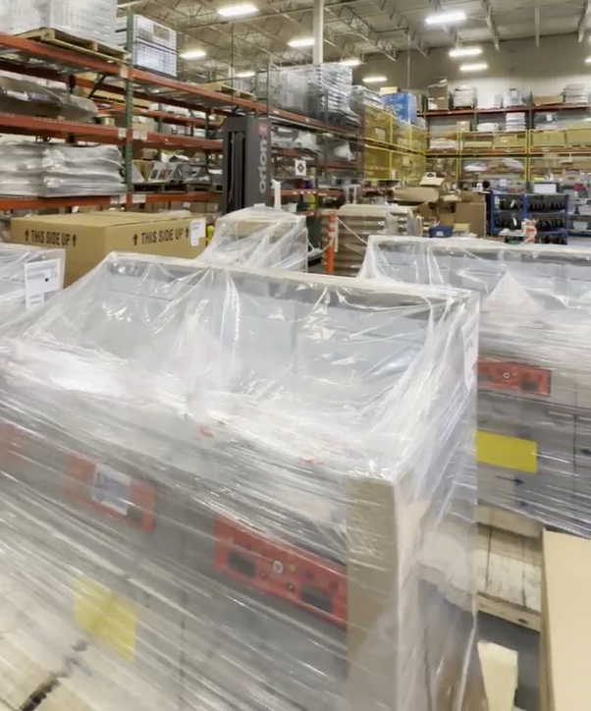
Pack and Ship
Adding appropriate Accessories, Stickers, user manuals
Audit
Wrap

Slide 11
Process Summary
Delays in the process for a variety of reasons
Tracking down materials
Rework for quality issues
On the spot training

Slide 12

Motivation and Main Opportunities
$4 million-dollar deal of power fryers with Buffalo Wild Wings.
demand for the company's VK-65 fryers with heat tracing increased.
Significant increase in production from 1 fryer every 3 months to 5 fryers per week.

Slide 13
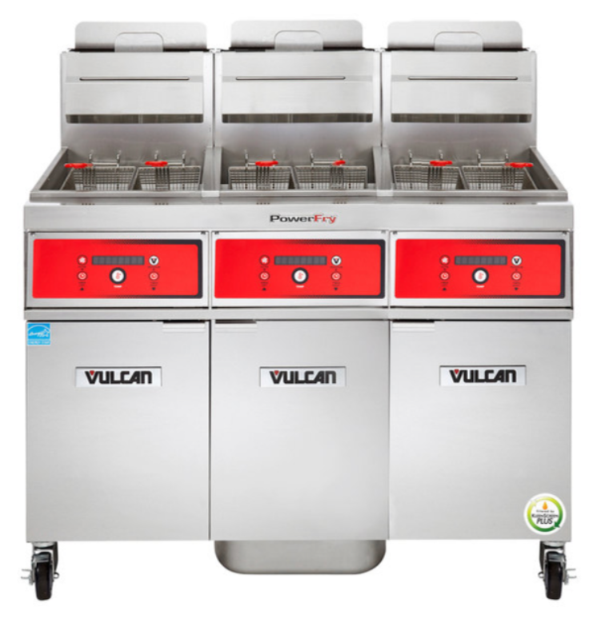
Motivation and Main Opportunities
Competitive advantage over its opponents by achieving minimal lead times .
further improvement by the introduction of QRM into different processes.
higher customer satisfaction, lower costs, increased revenue.

Slide 14
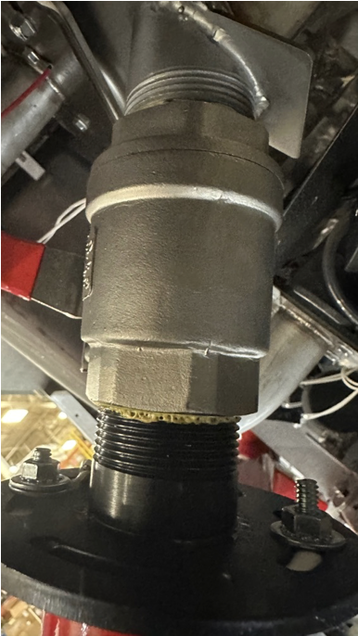
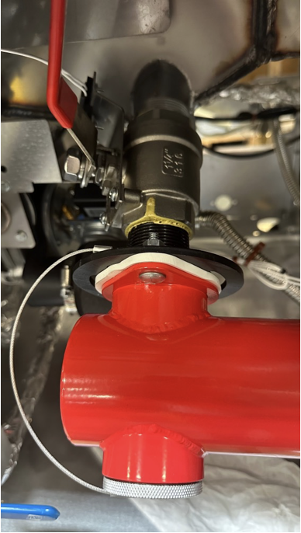
Motivation and Main Opportunities
Scope for improvement in
testing stations
material planning
employee training
Reduce the need to rework due to high failure rates.
Lower failure rates to lower costs and increase efficiency.

Slide 15

Motivation and Main Opportunities
Cross-trained employees helps to switch between different fryer lines quickly.
Results in higher productivity and efficiency.
This also helps when some important employees are on leave.

Slide 16
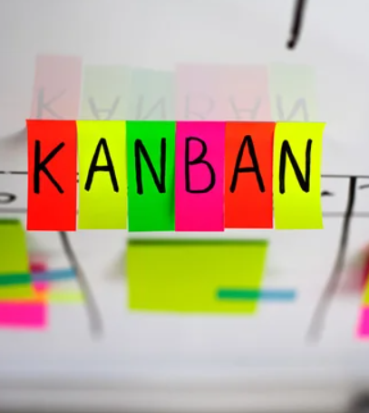
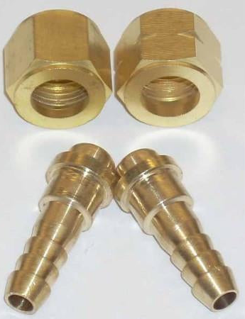
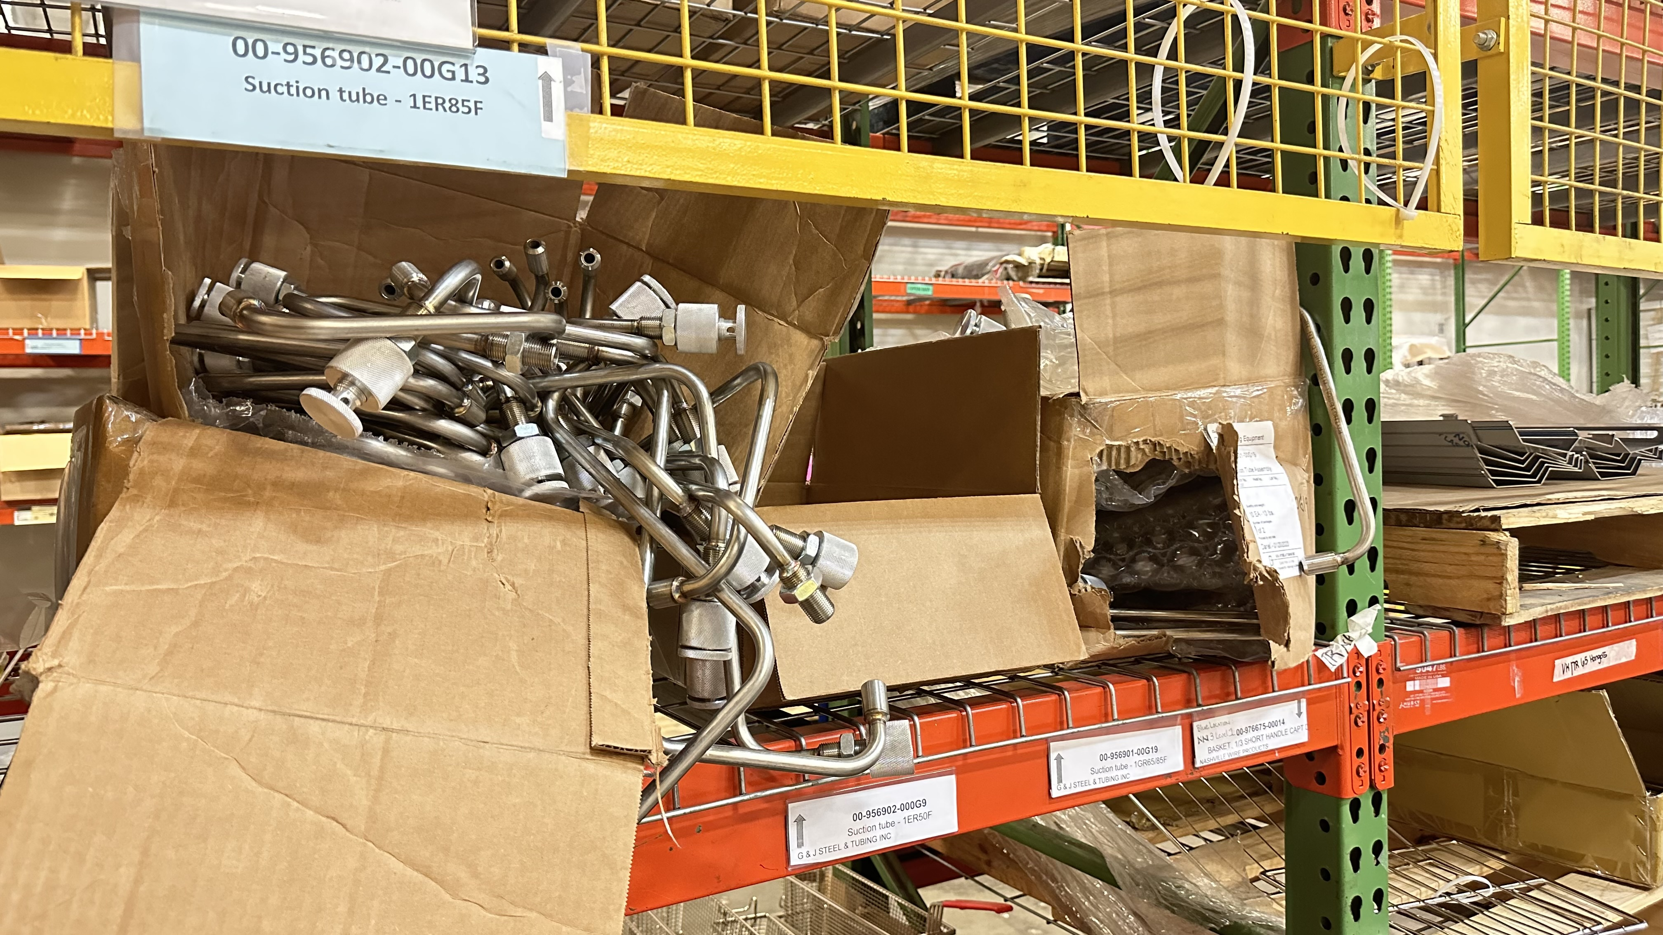
Problems faced
Lack of communication.
Low skilled labour.
Improper supply of materials.
Lack of co-ordination.
Lack of inspection.
Lack of organization.

Slide 17

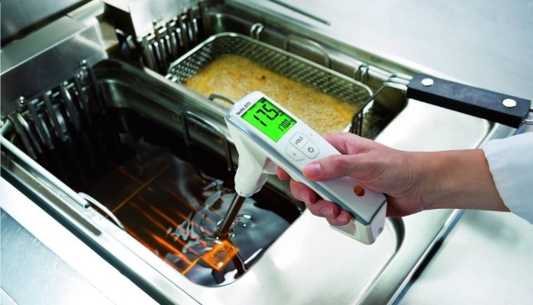
Project goals and scope
Reduce lead time from 22 weeks to 6 weeks.
Increase throughput from 8 tanks to 13 tanks.

Slide 18
Approach
Manufacturing Critical-path Time (MCT)
General
Buffalo Wild Wings
Create Simulation for Current Operations
PowerFry Line
Weeklong Operations
Create Alternatives
Increasing Testing Station Capacity
Adding Employees

Slide 19
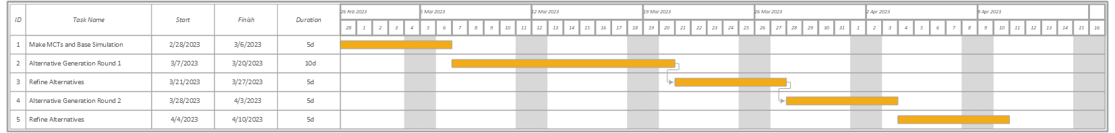
Execution plan
Make MCTs and Base Simulation
Generate Alternatives and Refine
Two Rounds
Implementation

